Slide 1
Automated Attendance System forRural Schools
CSE7302-University Project
Review-1
Batch Number: CDV_01
Under the Supervision of,
Dr. Saurabh Sarkar
Assistant Professor
School of Computer Science and Engineering
Presidency University
Roll Number | Student Name
20221CDV0012 | RAMYA V
20221CDV0019 | P ARCHITA
20221CDV0054 | SAI VRITHIKA JP
Name of the Program: Computer Science and Engineering(DevOps)
Name of the HoD: Dr. Pravinth raja S
Name of the Program Project Coordinator: Dr. H M Manjula
Name of the School Project Coordinators: Dr. Sampath A K , Dr. Geetha A

Slide 2
Problem Statement Number:25012
Organization:Government of Punjab
Category:Software
Problem Description:In many rural schools, student attendance is still recorded manually using paper registers, which consumes valuable classroom time and increases the workload of teachers. This traditional system is prone to errors such as incorrect entries, proxy attendance, and loss of records. Due to limited staff and digital infrastructure, maintaining accurate attendance data over long periods becomes difficult. Manual attendance methods also delay the generation of reports required for academic evaluation and government schemes. Parents and school authorities are unable to monitor student attendance in real time, leading to reduced accountability and delayed corrective actions. With the increasing availability of affordable smartphones and basic computing facilities, there is a growing need for a low-cost, reliable, and automated attendance system suitable for rural school environments. Such a system can improve accuracy, save time, reduce manipulation, and help schools maintain secure and efficient digital attendance records.

Slide 3
Content
Problem Statement
Objectives
Background and Related work for title Selection
Analysis of Problem Statement
Innovation or Novel Contributions
Git-hub Link
Timeline of the Project
References

Slide 4
Objectives
Primary Objective
To develop a low-cost automatic attendance marking system that improves accuracy and efficiency in rural schools while reducing manual effort.
Secondary Objectives
To eliminate manual attendance registers and reduce paperwork
To automate student attendance using digital identification methods
To prevent proxy attendance and data manipulation
To store attendance records securely in digital format
To generate daily, monthly, and yearly attendance reports automatically
To provide easy access to attendance data for teachers and school authorities
To design a system that works efficiently in low-resource rural environments

Slide 5
Background and Related work for title Selection
Traditional school attendance systems depend on manual record keeping, which is time-consuming and prone to errors.
Some urban schools use biometric or RFID-based attendance systems to improve accuracy.
These advanced systems are often expensive and require continuous power supply and regular maintenance.
Most existing digital attendance solutions are designed for urban institutions and are not suitable for rural conditions.
Rural schools face challenges such as limited internet connectivity and budget constraints.
Research shows that automated attendance systems improve accuracy and reduce administrative workload, but affordable and scalable solutions for rural schools are still limited.

Slide 6
Analysis of Problem Statement
Analysis of Problem Statement
Manual attendance marking wastes teaching time
High chances of proxy attendance and human errors
Difficulty in maintaining long-term attendance records
Lack of real-time attendance monitoring
Existing automated systems are costly and unsuitable for rural schools
Limited technical infrastructure in rural areas
Hence, there is a strong need for a cost-effective automated attendance system that addresses these challenges and improves the overall efficiency of attendance management in rural schools.

Slide 7
Github Link
The Github link provided should have public access permission.
Github Link

Slide 8
Innovation or Novel Contributions
Designed specifically for rural school environments
Low-cost implementation without expensive hardware
Reduces teacher workload and saves classroom time
Improves attendance accuracy and transparency
Prevents proxy attendance
Enables easy report generation and digital record storage
Scalable and adaptable for different rural school sizes

Slide 9
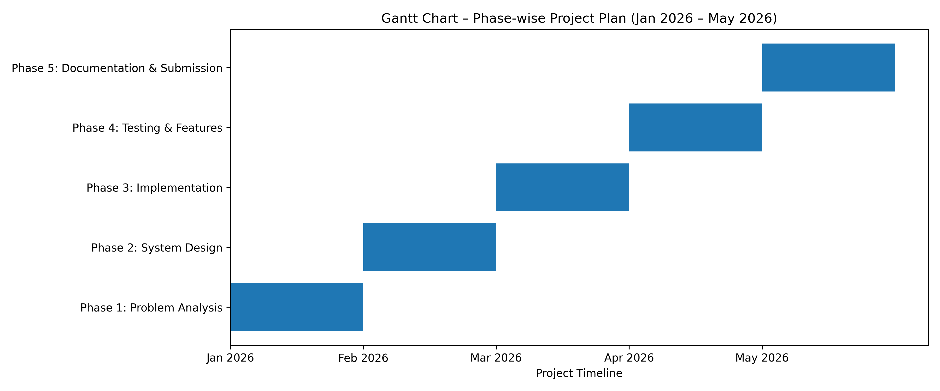
Timeline of the Project (Gantt Chart)

Slide 10
References (IEEE Paper format)
[1] S. Patil and R. Shinde, “Automatic attendance management system using mobile devices,” International Journal of Computer Applications, vol. 119, no. 6, pp. 45–50, 2015.
[2] A. Kumar and K. Bhatia, “Smart attendance system using digital technologies,” in Proc. IEEE Int. Conf. on Smart Systems, 2018.
[3] M. Singh, R. Verma, and P. Gupta, “Design and implementation of automated attendance system,” International Journal of Engineering Research, vol. 7, no. 4, pp. 112–117, 2019.
[4] R. Kumar and S. Kumar, “Biometric based attendance monitoring system,” International Journal of Scientific & Engineering Research, vol. 6, no. 5, pp. 1258–1262, 2015.

Slide 11
References (IEEE Paper format)
[5] P. Sharma and T. Mishra, “RFID based student attendance system,” International Journal of Advanced Research in Computer Science, vol. 8, no. 3, pp. 421–425, 2017.
[6] A. J. Singh and M. Kaur, “Face recognition based attendance system,” International Journal of Computer Science and Information Technologies, vol. 6, no. 4, pp. 3034–3038, 2015.
[7] N. A. Shinde and S. R. Patil, “Automated attendance system using IoT,” in Proc. Int. Conf. on Internet of Things and Applications, 2018, pp. 90–94.
[8] S. D. Chavan and P. R. Patil, “Smart classroom attendance management system,” International Journal of Emerging Technologies in Engineering Research, vol. 6, no. 2, pp. 15–19, 2018.

Slide 12


